Slide 1
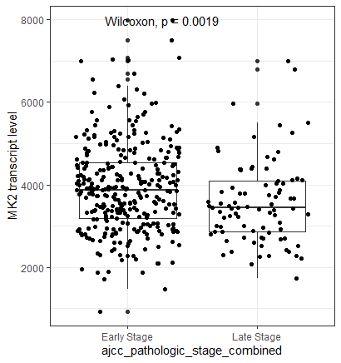
Boxplot show mean+/- SD of MK2 transcript levels in the TCGA-LUAD (Lung cancer) dataset. We divided the tumor stage into Early (Stage I-IIB) and Late (Stage IIIA and IV). MK2 expression was extracted from TCGA mRNA sequencing data

Slide 2
MK2 expression and death at 1 year in TCGA-LUAD
Model type | Early Stage |  |  | Late Stage
Variable | Model 1ª HR (95% CI) | Model 2^{b} HR (95% CI) | Model 3^{c} OR (95% CI) | Model 1 HR (95% CI) | Model 2 HR (95% CI) | Model 3^{c} OR (95% CI)
MK2 Expression | 0.76 (0.58, 0.99)^{d} | - | - | 0.87 (0.64,1.27)^{d} | - | -
High MK2 expression^{e} | - | 0.27 (0.09-0.79) | 0.20 (0.08,0.76) | - | 0.55 (0.17,1.73) | 0.53 (0.14,1.64)
Male Sex | 2.05 (0.98, 4.29) | 2.0 (0.98,4.26) | 2.0 (0.90, 4.42) | 1.11 (0.50,2.45) | 1.09 (0.50,2.40) | 1.21 (0.47,3.13)
Smoking | 1.05 (0.46,2.41) | 1.08 (0.47,2.46) | 1.15 (0.47,2.66) | 0.73 (0.32,1.66) | 0.75 (0.32,1.74) | 0.64 (0.24,1.76)
Age | 0.99 (0.95,1.03) | 0.98 (0.94, 1.03) | 0.98 (0.95,1.02) | 1.02 (0.97,1.06) | 1.02 (0.97,1.06) | 1.02 (0.97,1.07)
Caspase-3
ª Model 1: Cox Proportional hazards modeling of time to death, right censored at 1 year, as a function of MK2 expression, adjusted for age, sex and smoking status
^{b} Model 2: Cox Proportional hazards modeling of time to death, right censored at 1 year, as a function of high MK2 expression (dichomotous: top 1/3 vs bottom 2/3 of transcript expression), adjusted for age, sex and smoking status
^{c} Model 3: Logistic regression modeling death at one year as a function of high MK2 expression, adjusted for age, sex, and smoking status
^{d} per thousand transcripts MK2
^{e} Top 1/3 of MK2 transcript levels (reference: bottom 2/3)

Slide 3
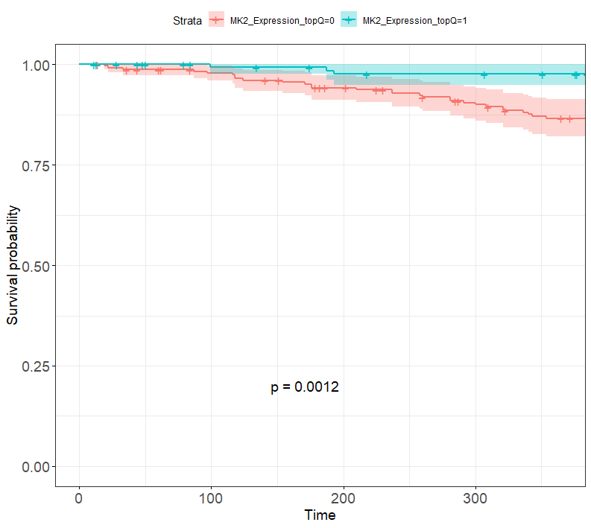
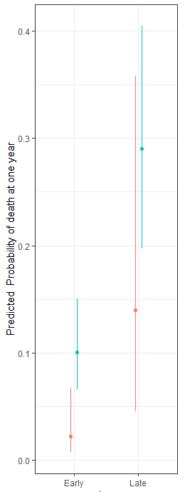
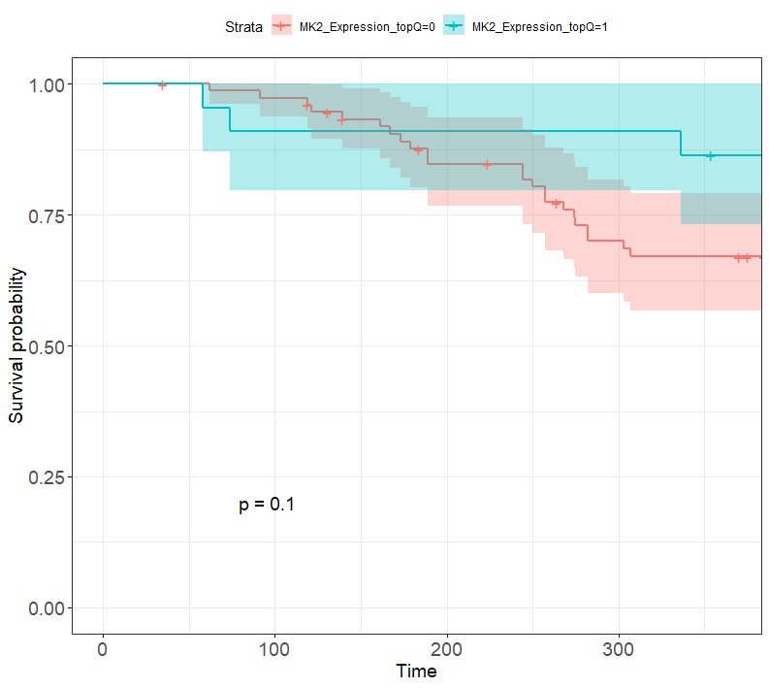
Model 2: Cox Proportional Hazards
Model 3: Logistic Regression
High MK2 Expression
Low MK2 Expression
Early Stage NSCLC
High MK2 Expression (top 1/3)
Low MK2 Expression (bottom 2/3)
Late Stage NSCLC
High MK2 Expression (top 1/3)
Low MK2 Expression (bottom 2/3)

Slide 4
MK2 expression and death at 1 year in TCGA-LUAD
Model type | Early Stage |  |  | Late Stage
Variable | Model 1ª HR (95% CI) | Model 2^{b} HR (95% CI) | Model 3^{c} OR (95% CI) | Model 1 HR (95% CI) | Model 2 HR (95% CI) | Model 3^{c} OR (95% CI)
MK2 Expression | 0.76 (0.58, 0.99)^{d} | - | - | 0.87 (0.64,1.27)^{d} | - | -
High MK2 expression^{e} | - | 0.27 (0.09-0.79) | 0.25 (0.08,0.76) | - | 0.55 (0.17,1.73) | 0.53 (0.14,1.64)
ª Model 1: Cox Proportional hazards modeling of time to death, right censored at 1 year, as a function of MK2 expression, adjusted for age, sex and smoking status
^{b} Model 2: Cox Proportional hazards modeling of time to death, right censored at 1 year, as a function of high MK2 expression (dichomotous: top 1/3 vs bottom 2/3 of transcript expression), adjusted for age, sex and smoking status
^{c} Model 3: Logistic regression modeling death at one year as a function of high MK2 expression, adjusted for age, sex, and smoking status
^{d} per thousand transcripts MK2
^{e} Top 1/3 of MK2 transcript levels (reference: bottom 2/3)

Slide 5
Data to be included in the supplemental

Slide 6
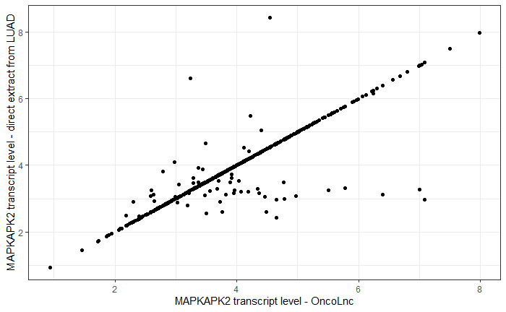

Slide 7
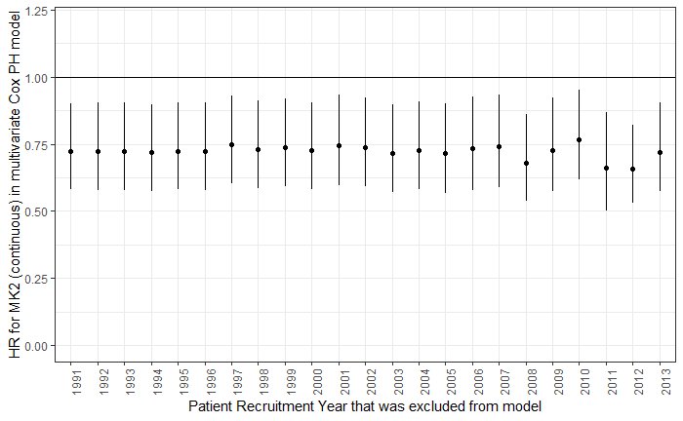
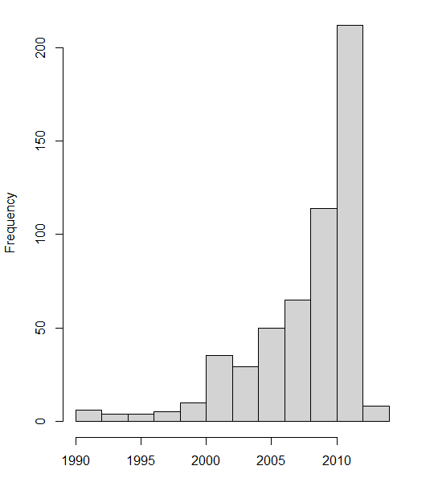

Slide 8
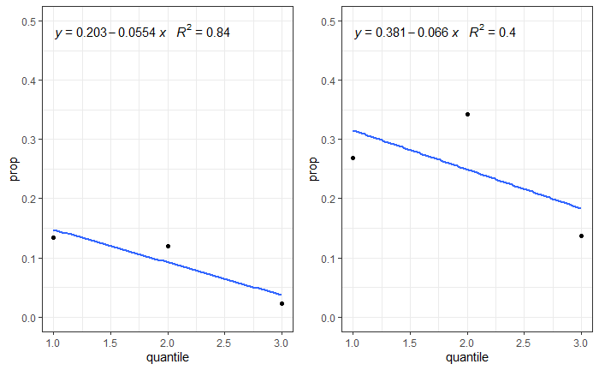
Early stage
Late stage
Graphs showing proportion of people who died within each quantile of MK2 expression in early- and late-stage NSCLC

Slide 9
Extra data – not included in supplemental

Slide 10
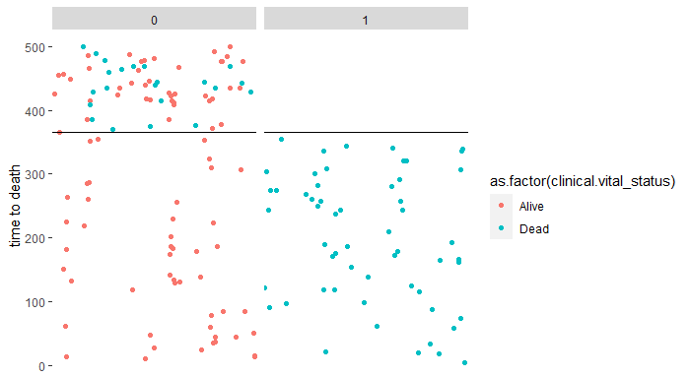
Death at one year status
Validation plot to make sure that censoring at one year was done properly. So, we have colored each patient’s vital status by alive or dead, and we have faceted by whether they were assigned as “Death in one year” or not. So, if our code worked, all patients who died in less than one year (blue color; y < 365) should be classified as dead at one year (“1”). All patients who were alive in that time period should be classified as red and in the “0” column. After 365 days, everyone should have gotten a classification of “0” for death at one year, since they are all by definition still alive at 1 year, regardless of subsequent alive or dead status (color should mix, all colors in the “0” column). And that’s what we see…

Slide 11
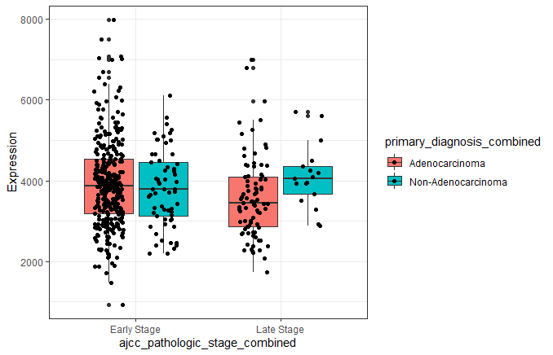
Boxplot show mean+/- SD of MK2 transcript levels in the TCGA-LUAD (Lung cancer) dataset subdivided by both stage and tumor histology. Though LUAD is a adenocarcinoma dataset, it does include some non-adenocarcinoma samples. We divided the tumor stage into Early (Stage I-IIB) and Late (Stage IIIA and IV). MK2 expression was extracted from TCGA mRNA sequencing data

Slide 12
Pan Cancer Analysis – not included in the current manuscript
Here, we ask the question: is this relationship between MK2 transcript and improved 1 year survival in early stage cancer something that is specific to lung adenocarcinoma, or do we see this in other tumor types. For this, we downloaded MK2 transcript data and clinical data for a variety of tumor types.

Slide 13
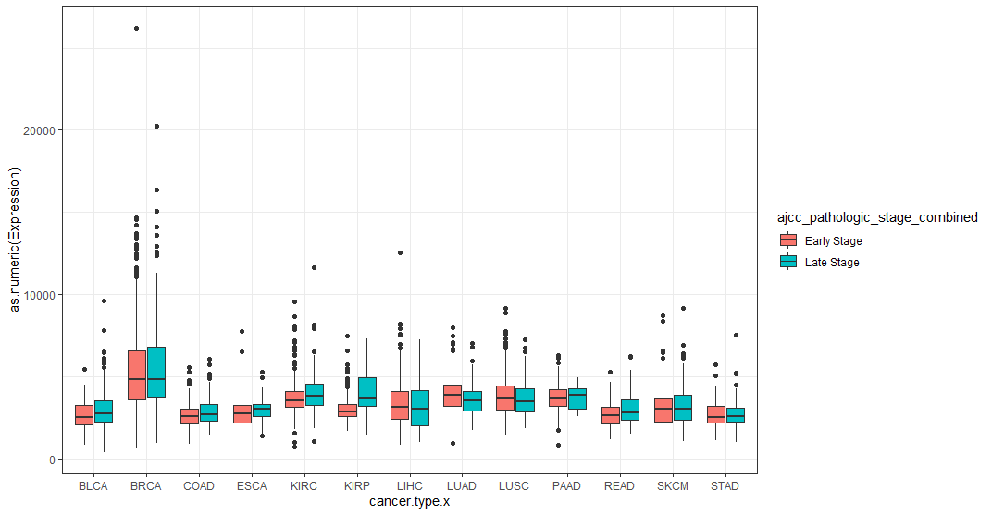
Boxplot show mean+/- SD of MK2 transcript levels in early vs. late stage cancer across cancer types. BLCA=bladder cancer, BRCA=breast cancer, COAD=colon adenocarcinoma; ESCA=Esophageal carcinoma; KIRC= Kidney renal clear cell carcinoma; KIRP=kidney renal papillary cell carcinoma; LIHC=liver hepatocellular carcinoma; LUAD=Lung adenocarcinoma; LUSC=Lung Squamous cell carcinoma; PAAD=pancreatic adenocarcinoma; READ=rectum adenocarcinoma; SKCM=skin cutaneous melanoma; STAD=stomach adenocarcinoma

Slide 14
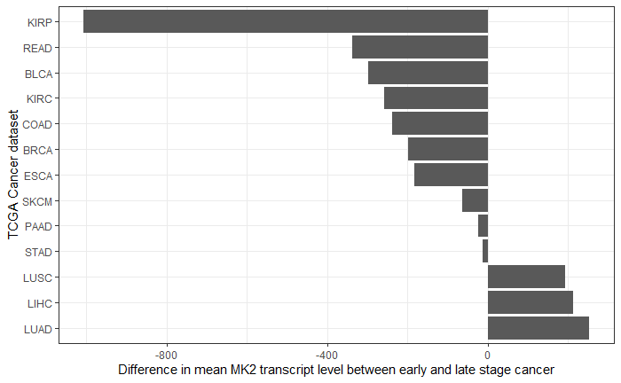
Bar graphs showing difference in MK2 transcript levels between early and late (i.e. Early-late transcript level) across cancer types. BLCA=bladder cancer, BRCA=breast cancer, COAD=colon adenocarcinoma; ESCA=Esophageal carcinoma; KIRC= Kidney renal clear cell carcinoma; KIRP=kidney renal papillary cell carcinoma; LIHC=liver hepatocellular carcinoma; LUAD=Lung adenocarcinoma; LUSC=Lung Squamous cell carcinoma; PAAD=pancreatic adenocarcinoma; READ=rectum adenocarcinoma; SKCM=skin cutaneous melanoma; STAD=stomach adenocarcinoma

Slide 15
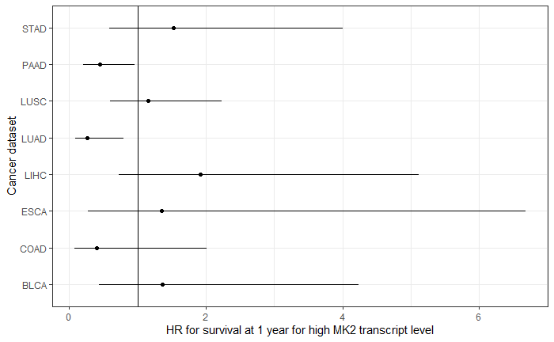
Forest plot showing Hazard ratio (and CI) for 1 year survival in patients with high MK2 transcript level (compared to low MK2 transcript level) in select early stage cancers. Interestingly, the phenomenon of lower HR is present only in lung adenocarcinoma (LUAD) and pancreatic adenocarcinoma (PAAD)

